Slide 1
Module-1:
Python Basic Concepts and Programming

Slide 2
Module-1: Python Basic Concepts and Programming :
Interpreter, Parts of Python Programming Language, Identifiers, Keywords, Statements and Expressions, Variables, Operators, Precedence and Associativity, Data Types, Indentation, Comments, Program Execution, Reading Input, Print Output, Type Conversions, The type( ) Function and Is Operator, Control Flow Statements, The if Decision Control Flow Statement, The if…else Decision Control Flow Statement, The if…elif…else Decision Control Statement, Nested if Statement, The while Loop, The for Loop, The continue and break Statements, Sequences – Strings, Built-In Functions, Commonly Used Modules, Function Definition and Calling the Function, The return Statement and void Function, Scope and Lifetime of Variables, Default Parameters, Keyword Arguments, *args and **kwargs, Command Line Arguments.

Slide 3
What is Python:
Python is an general purpose, Object-oriented, High-level, Dynamically Typed, Compiled and Interpreted programming language known for its simplicity and readability.
Common Uses of Python:
Web Development: Using frameworks like Django and Flask.
Data Analysis and Visualization: With libraries like Pandas, Matplotlib, and Seaborn.
Artificial Intelligence and Machine Learning: Leveraging tools like TensorFlow, PyTorch, and Scikit-learn.
Automation/Scripting: Automating repetitive tasks using Python scripts.
Game Development: Using libraries like Pygame.
Scientific Computing: Libraries like SciPy and SymPy are used for simulations and computations.
Software Development: For prototyping and backend development.

Slide 4
How Python is Compiled and Interpreted:
Python is often described as both a compiled and an interpreted language, depending on how you look at its execution process.
Compilation in Python:
When you run a Python program, it first goes through a compilation step.
The Python interpreter compiles the source code (.py file) into bytecode (a lower-level, platform-independent representation). This bytecode is stored in .pyc files (in the __pycache__ directory).
Note:
This compilation step is implicit and happens behind the scenes.
The bytecode is not directly executed by your machine; it is executed by the Python interpreter.

Slide 5
Interpretation in Python
The bytecode produced by the compilation step is executed by the Python Virtual Machine (PVM). The PVM interprets the bytecode line by line and executes it. This is what gives Python its "interpreted" behavior.
Key Points
Python is not a purely compiled language like C or C++, where code is compiled into machine code before execution.
Python is not a purely interpreted language like early versions of BASIC, which execute source code directly without compiling it.
Instead, Python uses a hybrid model: it compiles source code to bytecode (a form of intermediate code), which is then interpreted.

Slide 6
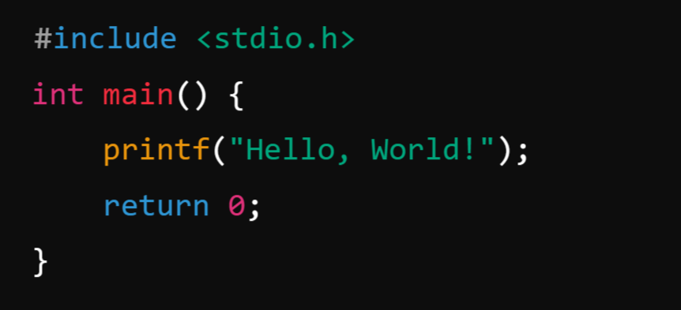
What is Compiler?
A compiler is a program that translates the entire source code of a programming language into machine code or intermediate code before execution. The compiled code is then executed directly by the computer's processor.
Example: C Language
Process: A C compiler (like GCC) compiles the code into a machine-readable .exe file, which can then be executed.

Slide 7

What is Interpreter?
An interpreter is a program that executes code line by line, translating it directly into machine code as it runs.
Example: Python:
Process: The Python interpreter reads the script line by line and executes it immediately.

Slide 8
Python Tokens:
In Python, tokens are the smallest units of the program that have a meaningful role. Python breaks every program into these tokens during the lexical analysis phase.
There are 5 types of Python tokens:
Keywords
Identifiers
Literals
String Literals
Numeric Literals
Boolean Literals
Special Literal (None)
Collection Literals
Operators
Punctuators

Slide 9
Parts of Python Programming Language:
Python programming language consists of several essential components and parts that work together to provide its functionality and versatility.
Identifiers
Keywords
Statements and Expressions
Variables
Operators
Precedence and Associativity
Data Types
Indentation
Comments
Program Execution
Reading Input and Print Output

Slide 10
Module-1: Python Basic Concepts and Programming :
Interpreter, Parts of Python Programming Language, Identifiers, Keywords, Statements and Expressions, Variables, Operators, Precedence and Associativity, Data Types, Indentation, Comments, Program Execution, Reading Input, Print Output, Type Conversions, The type( ) Function and Is Operator, Control Flow Statements, The if Decision Control Flow Statement, The if…else Decision Control Flow Statement, The if…elif…else Decision Control Statement, Nested if Statement, The while Loop, The for Loop, The continue and break Statements, Sequences – Strings, Built-In Functions, Commonly Used Modules, Function Definition and Calling the Function, The return Statement and void Function, Scope and Lifetime of Variables, Default Parameters, Keyword Arguments, *args and **kwargs, Command Line Arguments.

